Slide 1
Choosing Number of Clusters

Slide 2
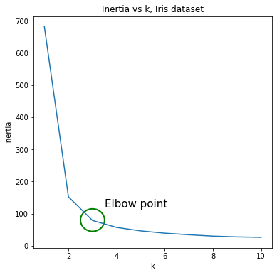
Inertia
Inertia drops with increasing number of clusters
We can look at elbow point in our curve for region of optimal k

Slide 3
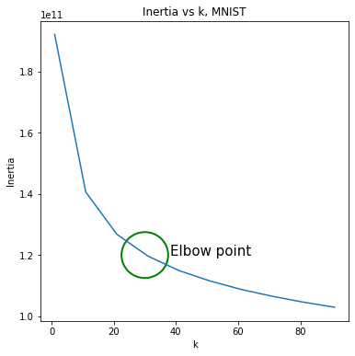
Inertia
Inertia drops with increasing number of clusters
We can look at elbow point in our curve for region of optimal k
However not always very clear and doesn’t always give an exact value but rather a range

Slide 4
Adjusted Random Index
Measure similarity of true class values to assigned class values
Perfect score is 1
Bad score (labels are independent) is negative or close to 0
However, requires knowledge of ground truth class
-> likely manual labeling

Slide 5
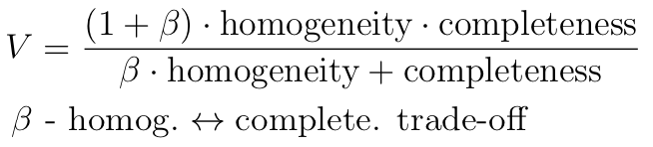
V-measure
Completeness: all true labels are assigned to the same cluster
Homogeneity: a cluster has only instances from one class assigned to it
Lower beta, more weight on homogeneity, higher completeness
Again requires knowledge of true values

Slide 6

Silhouette Coefficient
a - mean distance of a sample to all other samples in the same cluster
b - mean distance of a sample to all other samples in the nearest cluster
s - silhouette coefficient for one sample
Sil. coef. Per cluster given as mean s for each sample in cluster

Slide 7
Silhouette Coefficient
s - silhouette coefficient for one sample
Sil. coef. Per cluster given as mean s for each sample in cluster
1 is good, -1 is bad, 0 is clusters have overlap
Dense and well defined clusters have high scores

Slide 8
Silhouette Analysis
Plot silhouette coefficient for every instance in every cluster
Plot average silhouette score

Slide 9
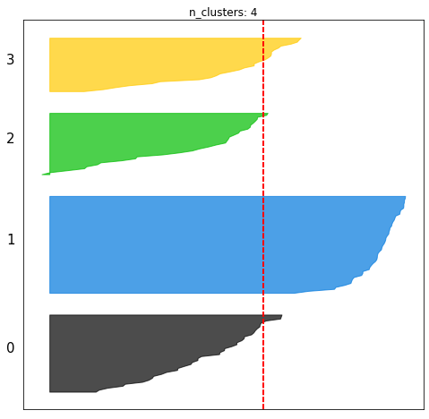
Silhouette Analysis
Selection criteria
Look for graphs where no max silhouette coefficient of a cluster lies below average
Look for graphs where fluctuations of silhouette scores across clusters is low
Look for graphs with clusters of similar sizes

Slide 10
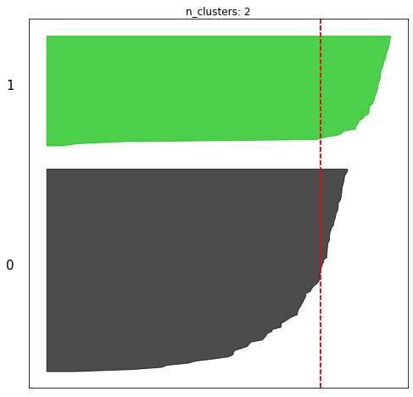
Silhouette Analysis
Selection criteria
Look for graphs where no max silhouette coefficient of a cluster lies below average
Look for graphs where fluctuations of silhouette scores across clusters is low
Look for graphs with clusters of similar sizes

Slide 11
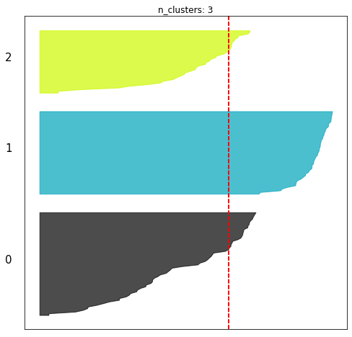
Silhouette Analysis
Selection criteria
Look for graphs where no max silhouette coefficient of a cluster lies below average
Look for graphs where fluctuations of silhouette scores across clusters is low
Look for graphs with clusters of similar sizes

Slide 12
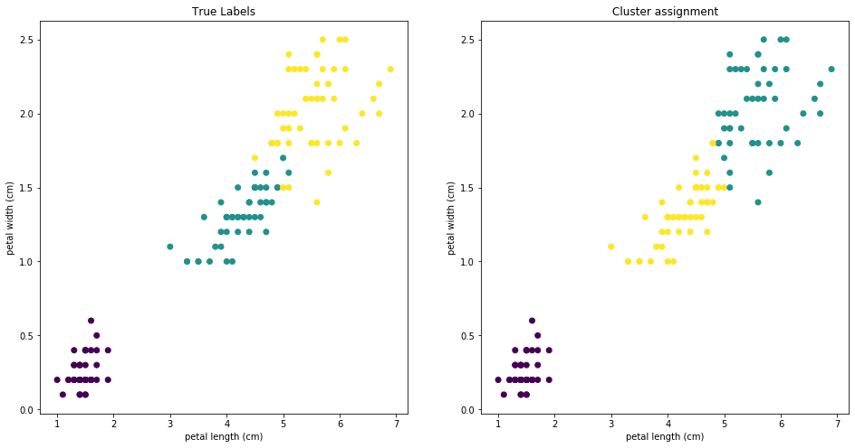
Silhouette Analysis
Selection criteria
Look for graphs where no max silhouette coefficient of a cluster lies below average
Look for graphs where fluctuations of silhouette scores across clusters is low
Look for graphs with clusters of similar sizes

Slide 13
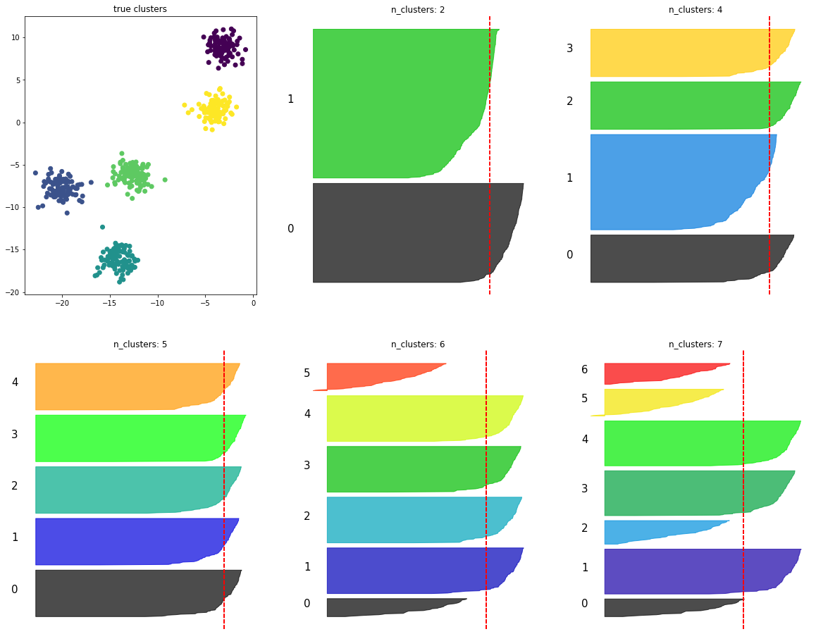
Silhouette Analysis
Selection criteria
Look for graphs where no max silhouette coefficient of a cluster lies below average
Look for graphs where fluctuations of silhouette scores across clusters is low
Look for graphs with clusters of similar sizes

